Slide 1
WEBMONK (COURSE DAY - 10)
Topics covered:
* what is database & its types?
* SQL vs NOSQL
* More on NOSQL
* MongoDB basics
* MongoDB CRUD

Slide 2
DATABASE & ITS TYPES

Slide 3
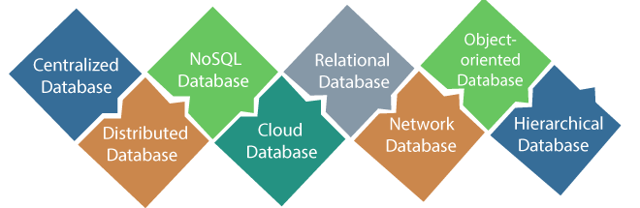
DATABASE & ITS TYPES
a database is an organized collection of structured information, or data, typically stored electronically in a computer system. A database is usually controlled by a database management system (DBMS). Together, the data and the DBMS, along with the applications that are associated with them, are referred to as a database system, often shortened to just database.

Slide 4
SQL VS NOSQL

Slide 5
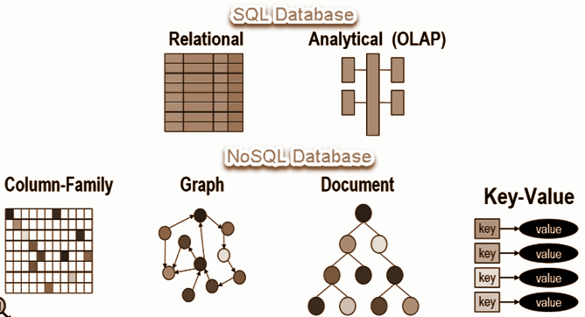
SQL VS NOSQL
* SQL databases are relational, NoSQL are non-relational.
* SQL databases use structured query language and have a predefined schema. NoSQL databases have dynamic schemas for unstructured data.
* SQL databases are vertically scalable, NoSQL databases are horizontally scalable.
* SQL databases are table based, while NoSQL databases are document, key-value, graph or wide-column stores.
* SQL databases are better for multi-row transactions, NoSQL are better for unstructured data like documents or JSON.

Slide 6
MONGODB BASICS

Slide 7
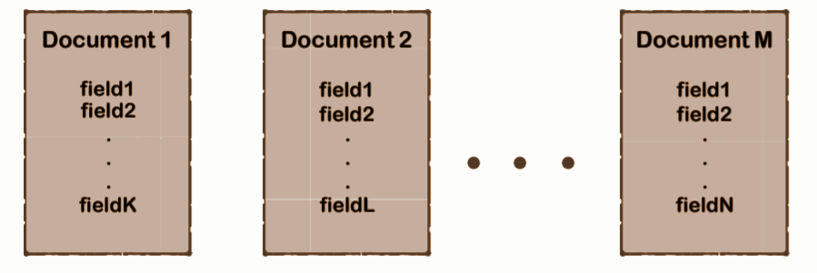
WHAT IS MONGODB?
* MongoDB is a cross-platform document-oriented database program.
* Classified as a NoSQL database program, MongoDB uses JSON-like documents with optional schemas.

Slide 8
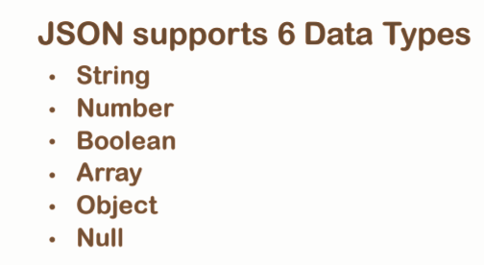
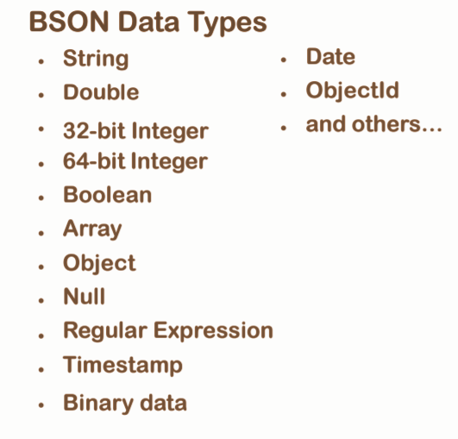
JSON VS BSON
* JSON a.k.a JavaScript Object Notation is an open standard file format, and data interchange format, that uses human-readable text to store and transmit data objects consisting of attribute–value pairs and array data types.
* BSON is a computer data interchange format. The name "BSON" is based on the term JSON and stands for "Binary JSON". It is a binary form for representing simple or complex data structures including associative arrays, integer indexed arrays, and a suite of fundamental scalar types. BSON originated in 2009 at MongoDB.

Slide 9
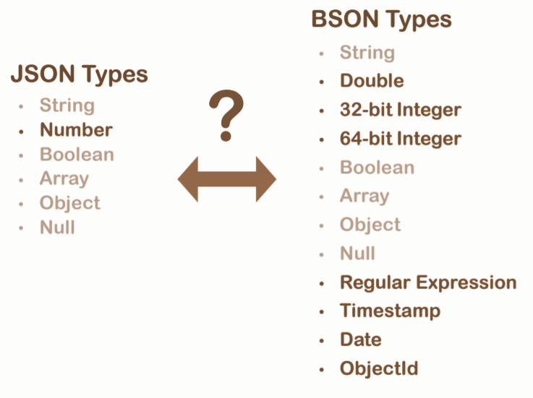
CONVERSION

Slide 10
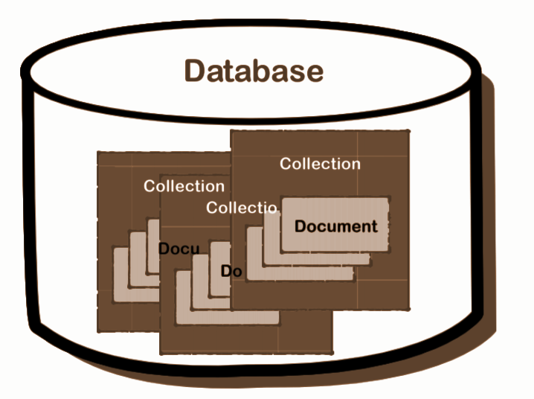
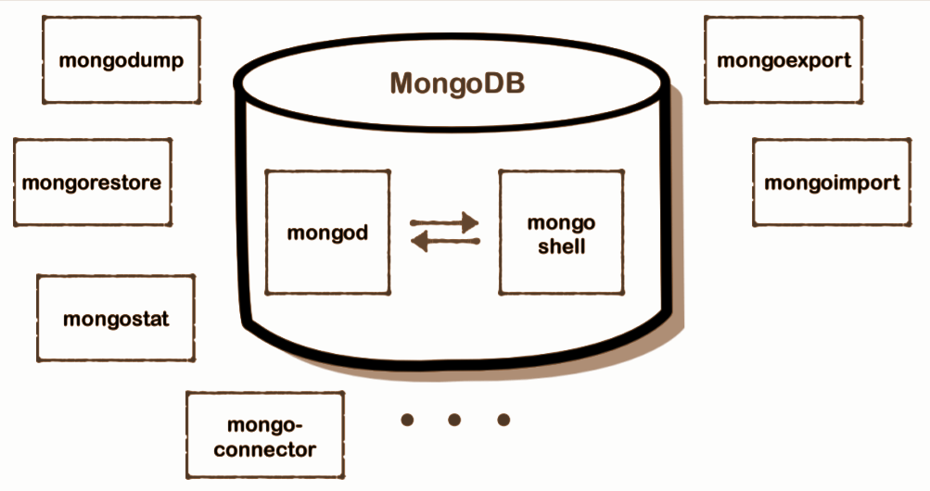
MONGO STRUCTURE & ARCHITECTURE

Slide 11
SOME CRUD WITH MONGODB**

Slide 12
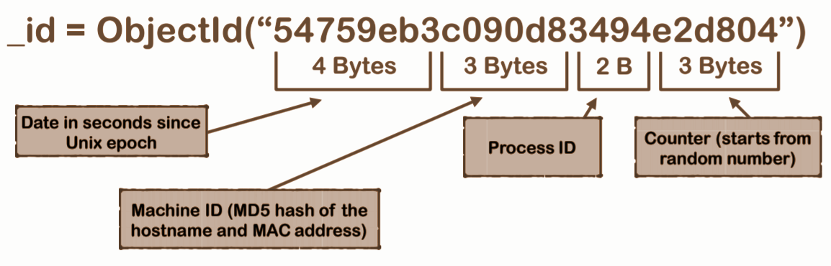
WHAT IS _id?
* Mandatory document field.
* Can be assigned manually.
* Will be created automatically if not assigned manually (recommended)

Slide 13
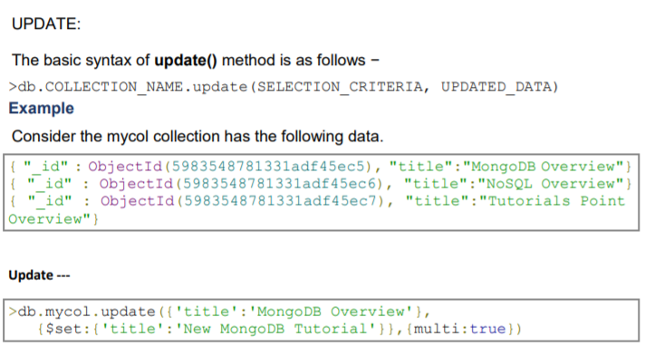
UPDATE

